Slide 1


Daniel Eseme S/N 100841468
Assignment 3 – Neural Networks

Slide 2
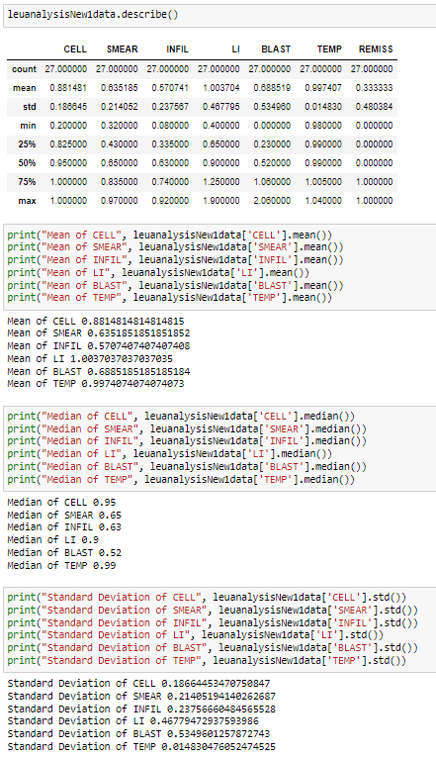
Six (6) Independent Variables
(CELL, SMEAR, INFIL, LI, BLAST, TEMP)
CELL
The average (0.881481) of CELL in the Leukemia remission dataset is rightly skewed from the max.
The spread (0.186645) of the CELL when multiplied by a number, is used to capture non-outliers in a sample
SMEAR
the minimum value of SMEAR (0.320000) is not an outlier
OTHERS
At 75%, CELL has already hit it’s max while std is still an outlier
At 75%, (SMEAR, INFIL) are still not close to their max
At 50% BLAST (0.000000) was at a dead low, which is bad for the dataset

Slide 3
Classification Report
Given how small the dataset is, this seems to be a strong show of our test, and this is significant, less worry on other assumptions. Two classes (0 and 1)
Precision
At (0) precision is high at (0.75), though not good or high, I believe it is fine as compared to the size of the dataset and independent variable chosen
While at (1) precision is at a low of (0.50) but still well set out
Recall
Recall at both class levels (0 and 1) stays stagnant at 0.50 and 0.50
F1-Score
Is at a denotes a bad classifier away from 1

Slide 4
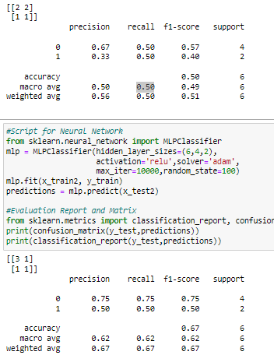
Compare the classification report from Neural Network Algorithm to the Logistical Regression Algorithm
Neural network did well as compared to the logistical Regression Algorithm.
As seen on the picture on the left, smaller dataset but not much of a significant growth
F-1 Score, shows an increase of the weighted average of (0.51) to (0.67). There seems to be a bad functionality on the logistical side of the data set.
All the scores do show an overall increase giving a very comfortable analysis
Recall, also comes with an increase and shows a better model, better performance and functionality.
Precision, comes with an increase aligning with f1 and recall. In terms of the macro avg and weighted avg showing a better analysis of how good the Neural Network is.
In conclusion, the neural network is a good model to keep going forward while checking for errors, especially for this and small datasets

